Slide 1
Client Side Storage Or Web Storage
Lesson-15
Capgemini Public
Notes:
Can access OS file api

Slide 2

Lesson Objectives
HTML5 Client-side storage or Web Storage
  Persistent Storage With Local Storage
Capgemini Public
Notes:
Explain the lesson coverage

Slide 3
HTML5 Client-side storage or Web Storage
Web storage is a general term for several separate but related APIs like Web Storage, Web SQL Database, Indexed Database, and File Access. Each of these techniques provides a distinct way to store data on the user's hard drive, instead of the server, where data usually resides.
Web Storage make the web app available offline.
Web Storage improve performance
Received a lot of criticism because of its lack of security, but it is nonetheless an interesting innovation
Capgemini Public
Notes:
Explain the lesson coverage

Slide 4
HTML5 Client-side storage or Web Storage
Divided into 3 methodologies
  Session Storage
  Local Storage
  Database Storage
  Local storage and Session Storage are called as Web Storage or DOM storage
  This are used in place of cookies
  Local storage is persistent.
  Session storage is not persistent
  Both use the Storage() interface
  Supported by all latest browser.
Capgemini Public
Notes:
Explain the lesson coverage

Slide 5
5.2: Introducing Types of HTML5 Client-Side Storage
Session Storage
Isn't much different from that what cookies offer, but has some additional benefits
  Session storage allows much more space, usually in megabytes
  Depending on the browser implementation, the exact space can vary
  Session data isn't sent automatically
  Each tab/window maintains its own session information, as far as the site is concerned
Session Storage should be used to store short lived data related to a single browser window
Data doesn't persist after the window is closed
Methods for storing & retrieving data
  setItem(key,value): adds a key/value pair to the storage object
  getItem(key): retrieves the value for a given key
  clear(): removes all key/value pairs for the storage object
  removeItem(key): removes a key/value pair from the storage object
Capgemini Public

Slide 6
5.2: Introducing Types of HTML5 Client-Side Storage
Session Storage - Example
Example
sessionStorage.setItem('username',‘shilpa');
sessionStorage.getItem('username');
Capgemini Public

Slide 7
5.2: Introducing Types of HTML5 Client-Side Storage
Local Storage
The local Storage JavaScript object is functionally identical to the session Storage object
Only differ in persistence and scope
  Persistence: localStorage is used for long-term storage
  Scope: localStorage data is accessible across all browser windows while sessionStorage data is confined to the browser window that it was created in
  Examples
localStorage.setItem('username',‘Shilpa');
localStorage.getItem('username');
localStorage.clear();
Capgemini Public
Notes:
Local Storage:
One LocalStorage per web application, with a max size of 5MB, is available for a
given browser and is shared by all windows and tabs of that browser. For example,
suppose you have MyWebApp running in a Chrome browser on the client. If you run
MyWebApp in multiple tabs and windows, they all share the same Local Storage data
,subject to a max limit of 5MB. If you were to then open that same application in
another browser, say FireFox, then the new browser would get its own LocalStorage
to share with all its own tabs and windows.
HTML5 local storage saves data in string form as key-value pairs. If the data you
wish to save is not string data, you are responsible for conversion to and from string
when using LocalStorage.
HTML5 local storage saves data unencrypted in string form in the regular browser
cache. It is not secure storage. It should not be used for sensitive data, such as
social security numbers, credit card numbers, logon credentials, and so forth.

Slide 8
5.2: Introducing Types of HTML5 Client-Side Storage
Database Storage
When dealing with a larger amount of content, it would be nice to be able to store it in a structured manner and be able to access it randomly
With HTML 5, you get database storage, which allows you to save structured data in the client's machine using a real SQL database
Limitations
  Safari is the only browser to have implemented this feature with SQLite Database
  No specifications on available SQL commands
  The SQLite database also lacks the Foreign Key Constraint
Capgemini Public

Slide 9
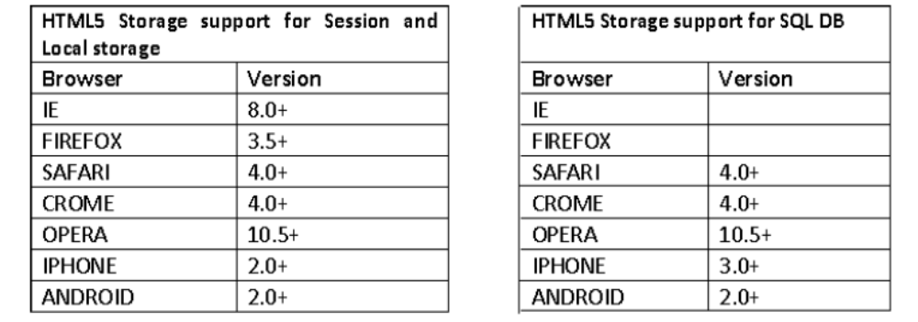
5.2: Introducing Types of HTML5 Client-Side Storage
Database Storage
Current local database implementation is not quite fit for use, because of a few basic deficiencies such as
  Data is not encrypted
  Accessible by anyone
  There is no way to directly sync the local database with the one on the server
  Limited memory space
Still, local database is going to be one of the key features in the future of browsers
Capgemini Public

Slide 10
5.2: HTML5: Enhanced Form Elements
Demo
LocalStorage.html
SessionStorage.html
Capgemini Public

Slide 11

Summary
In this module, you have learnt:
  The HTML5 (web) storage spec is a standardized way of providing larger amounts of client-side storage
  Without HTML5, client-side storage for web applications is limited to the tiny storage provided by cookies
  A web application can achieve better performance and provide a better user experience if it uses this local storage
Capgemini Public

Slide 12
Summary
In this module, you have learnt:
  HTML5 Client-Side storage is divided into three categories
  Session Storage - Its similar to cookies but varies in size, accessible only withing the window or a tab that created it
  Local Storage - It can store 5MB per app per browser & deleted by user or by the app
  Database Storage - It provides good performance generally, being an asynchronous API.
  How to implement Client Side Storage in HTML5
Capgemini Public

Slide 13

Review Question
Fill in the blank
  ________ storage allows much more space, usually in megabytes
  __________ method removes a key/value pair from the storage object
  Safari is the only browser to have implemented this feature with _______ Database
Capgemini Public
Notes:
A. Session Storage
B. removeItem(key)
C. SqlLite DB

